Slide 1
Single Source Shortest Paths
All-Pairs Shortest Paths
Algorithms & Data Structures
ITCS 6114/8114
Dr. Dewan Tanvir Ahmed
Department of Computer Science
University of North Carolina at Charlotte

Slide 2
Outline
Single Source Shortest Paths
Bellman-Ford algorithm
Shortest Paths in DAG
All-Pairs Shortest Paths
Floyd-Warshall algorithm

Slide 3
Shortest Path Properties
We have optimal substructure: the shortest path consists of shortest subpaths:
Proof: suppose some subpath is not a shortest path
There must then exist a shorter subpath
Could substitute the shorter subpath for a shorter path
But then overall path is not shortest path. Contradiction

Slide 4
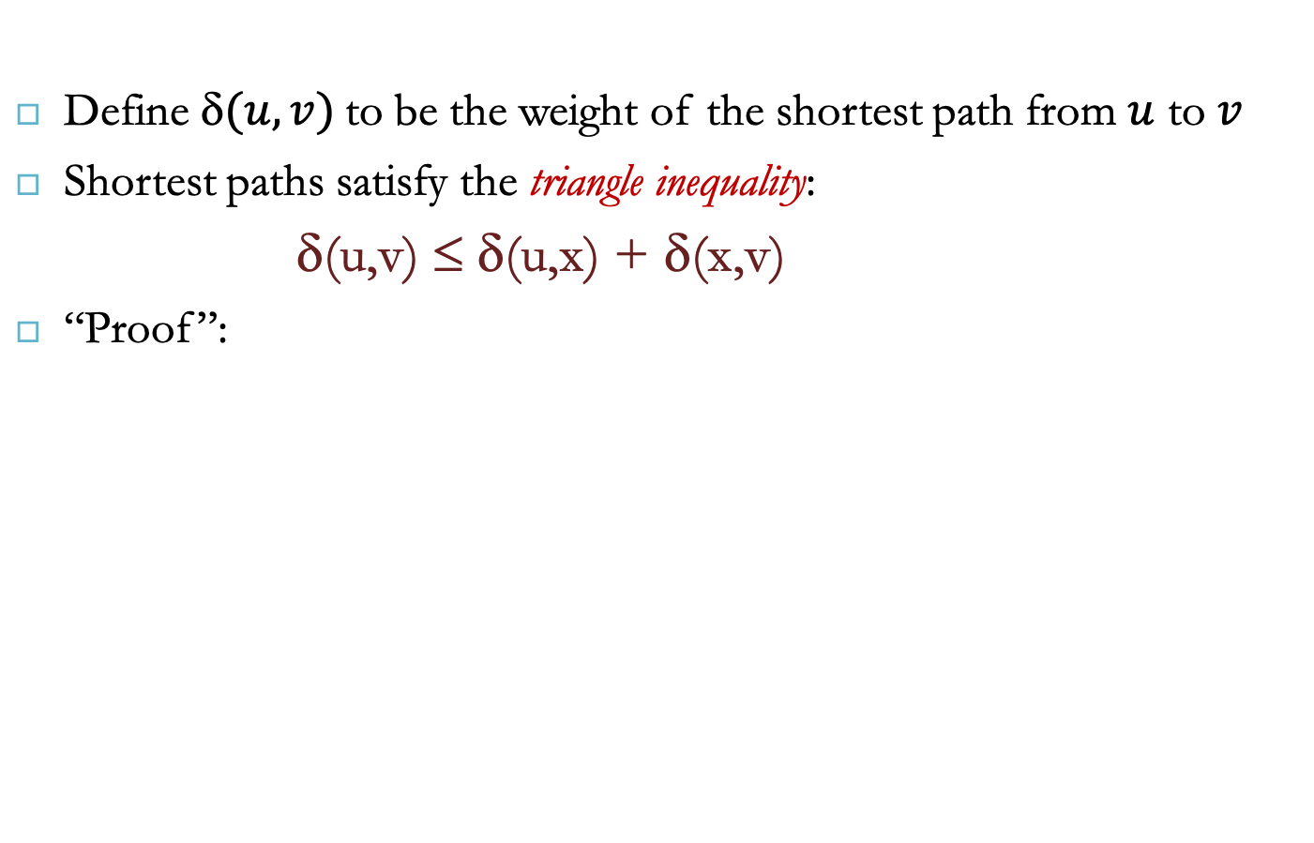
Shortest Path Properties
Define $(u,v)$to be the weight of the shortest path from $u$ to $v$
Shortest paths satisfy the triangle inequality:
δ(u,v) ≤ δ(u,x) + δ(x,v)
“Proof”:
x
u
v
This path is no longer than any other path

Slide 5
Shortest Path Properties
In graphs with negative weight cycles, some shortest paths will not exist.
Why?
< 0

Slide 6
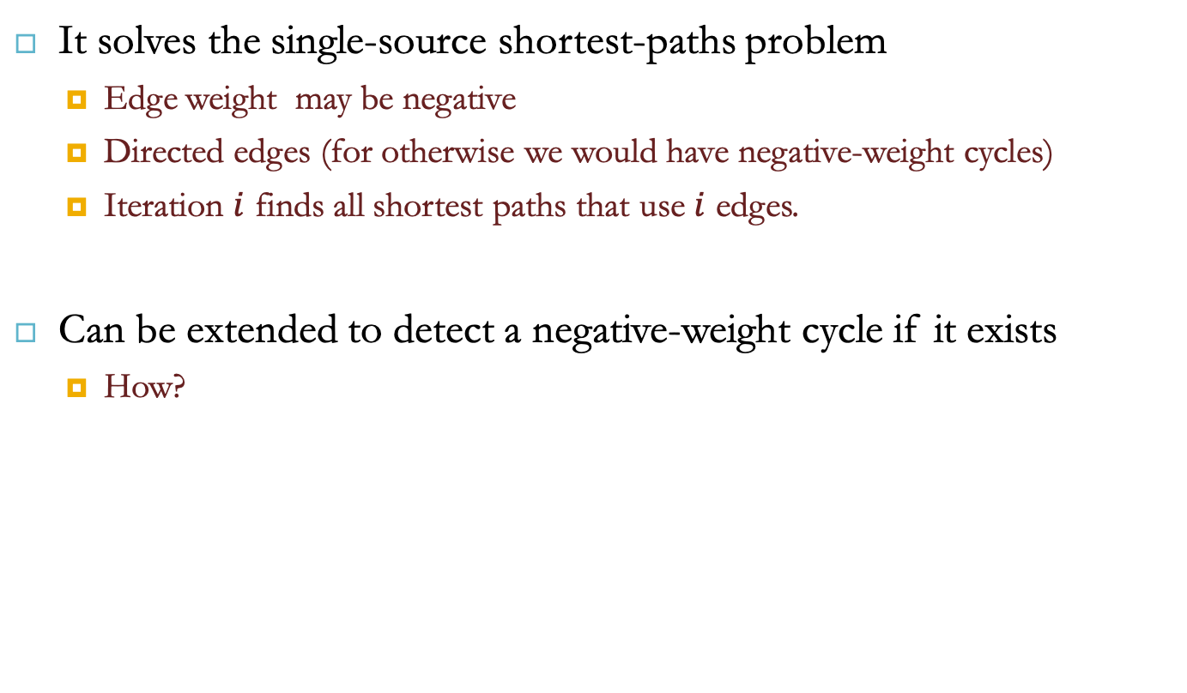
Bellman-Ford Algorithm
It solves the single-source shortest-paths problem
Edge weight may be negative
Directed edges (for otherwise we would have negative-weight cycles)
Iteration $i$ finds all shortest paths that use $i$ edges.
Can be extended to detect a negative-weight cycle if it exists
How?

Slide 7
Bellman-Ford Algorithm
BellmanFord()
for each v ∈ V
d[v] = ∞;
d[s] = 0;
for i=1 to |V|-1
for each edge (u,v) ∈ E
Relax(u,v, w(u,v));
for each edge (u,v) ∈ E
if (d[v] > d[u] + w(u,v))
return “no solution”;
Initialize d[], which
will converge to shortest-path value δ
Relaxation: Make |V|-1 passes,
relaxing each edge
Test for solution
Relax(u,v,w): if (d[v] > d[u]+w) then d[v]=d[u]+w

Slide 8
Bellman-Ford: Example 1
Nodes are labeled with their d(v) values
8
0
4
8
0
4
-2
-2
7
1
8
7
-2
1
4
∞
∞
∞
∞
∞
∞
3
9
3
9
-2
∞
∞
5
-2
∞
∞
5
8
0
4
8
0
4
-2
-2
5
8
7
-2
1
4
-1
5
7
-2
1
-1
1
3
9
3
9
-2
6
9
5
-2
4
5
∞
∞
1
9

Slide 9
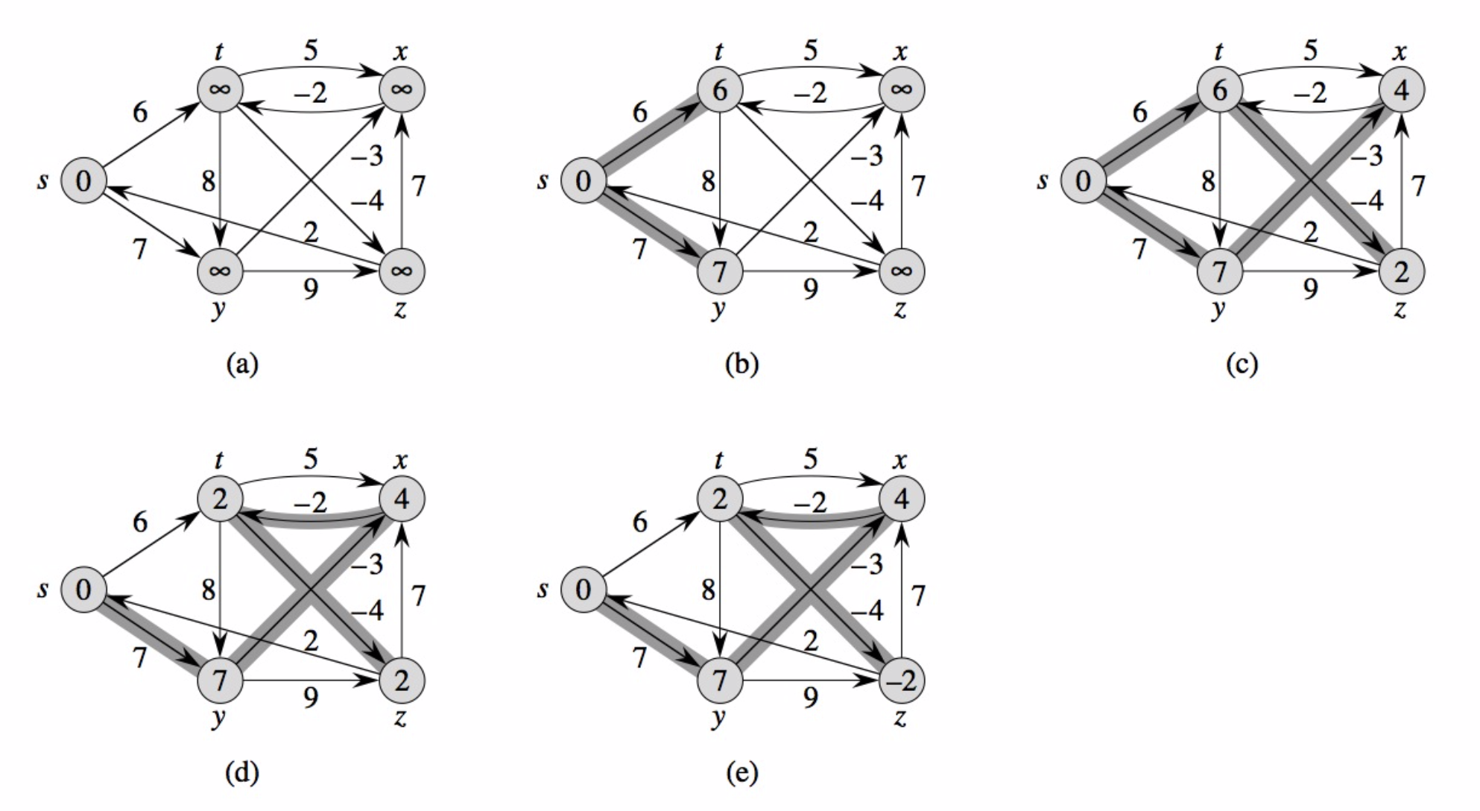
Bellman-Ford: Example 2

Slide 10
Analysis: Bellman-Ford Algorithm
Run-time?
BellmanFord()
for each v ∈ V
d[v] = ∞;
d[s] = 0;
for i=1 to |V|-1
for each edge (u,v) ∈ E
Relax(u,v, w(u,v));
for each edge (u,v) ∈ E
if (d[v] > d[u] + w(u,v))
return “no solution”;
Θ(V)
Θ(V)
Θ(E)
Θ(1)
Θ(E)
Bellman-Ford
= Θ(V) + VE Θ(1) + E =
= Θ(VE)

Slide 11
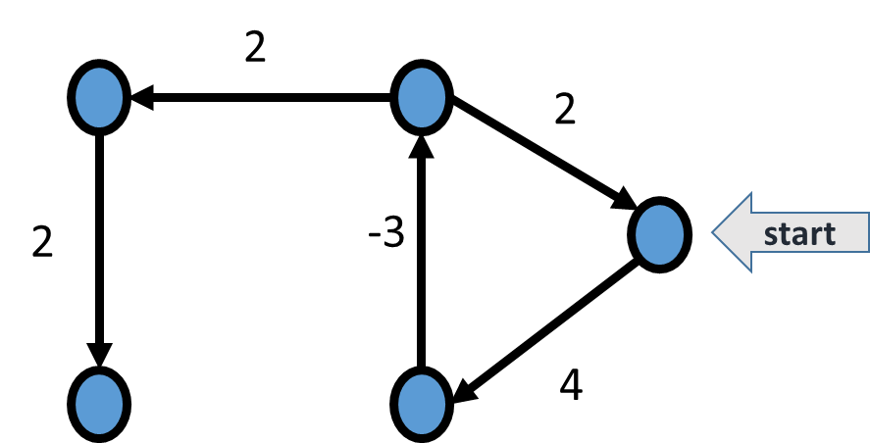
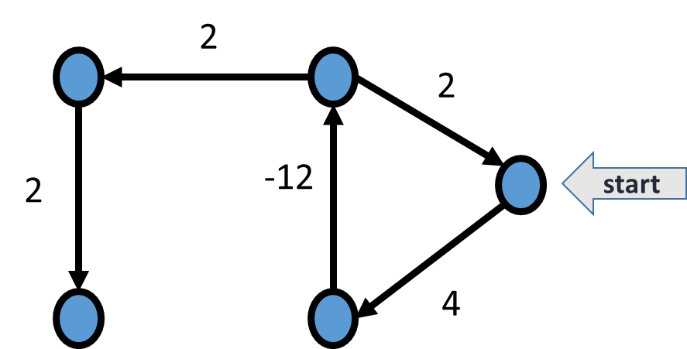
Negative Weights and Cycles?
Negative edges are OK, as long as there are no negative weight cycles (otherwise paths with arbitrary small “lengths” would be possible)
Example?

Slide 12
Negative Weights and Cycles?
Shortest-paths can have no cycles (otherwise we could improve them by removing cycles)
Any shortest-path in graph G can be no longer than n – 1 edges, where n is the number of vertices

Slide 13
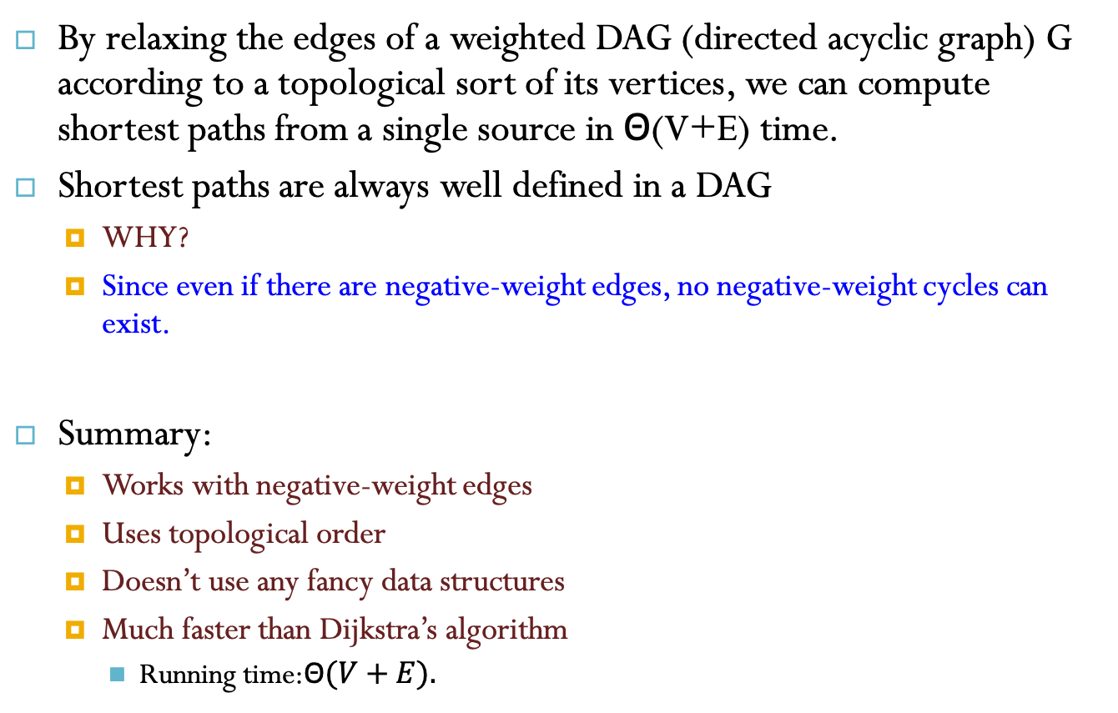
DAG-based Algorithm
By relaxing the edges of a weighted DAG (directed acyclic graph) G according to a topological sort of its vertices, we can compute shortest paths from a single source in Θ(V+E) time.
Shortest paths are always well defined in a DAG
WHY?
Since even if there are negative-weight edges, no negative-weight cycles can exist.
Summary:
Works with negative-weight edges
Uses topological order
Doesn’t use any fancy data structures
Much faster than Dijkstra’s algorithm
Running time:Θ$(V+E).$

Slide 14
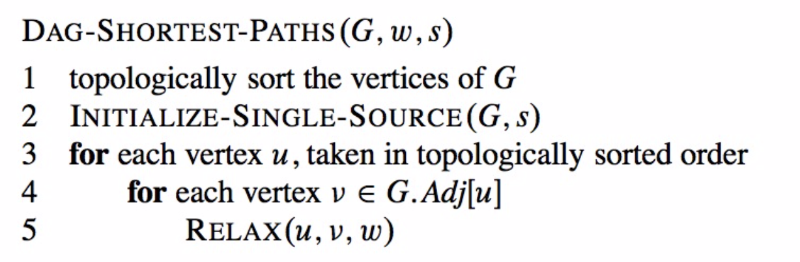
DAG-based Algorithm

Slide 15
DAG: Example 1
Nodes are labeled with their d(v) values
1
1
8
0
4
8
0
4
-2
-2
3
7
2
1
4
3
8
7
2
-2
1
4
4
∞
∞
∞
∞
∞
∞
3
9
3
9
-5
∞
∞
5
-5
∞
∞
5
6
5
6
5
1
1
8
0
4
8
0
4
-2
-2
3
5
7
2
1
4
-1
3
7
2
1
4
8
-2
4
5
-2
-1
3
9
3
9
-5
1
7
5
-5
0
4
5
∞
∞
1
7
6
5
6
5
(two steps)

Slide 16
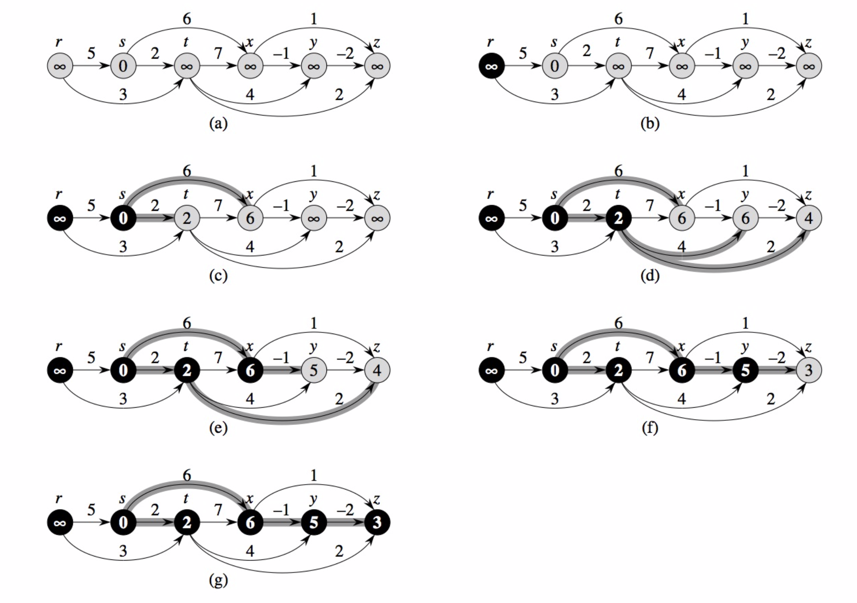
DAG: Example 2

Slide 17
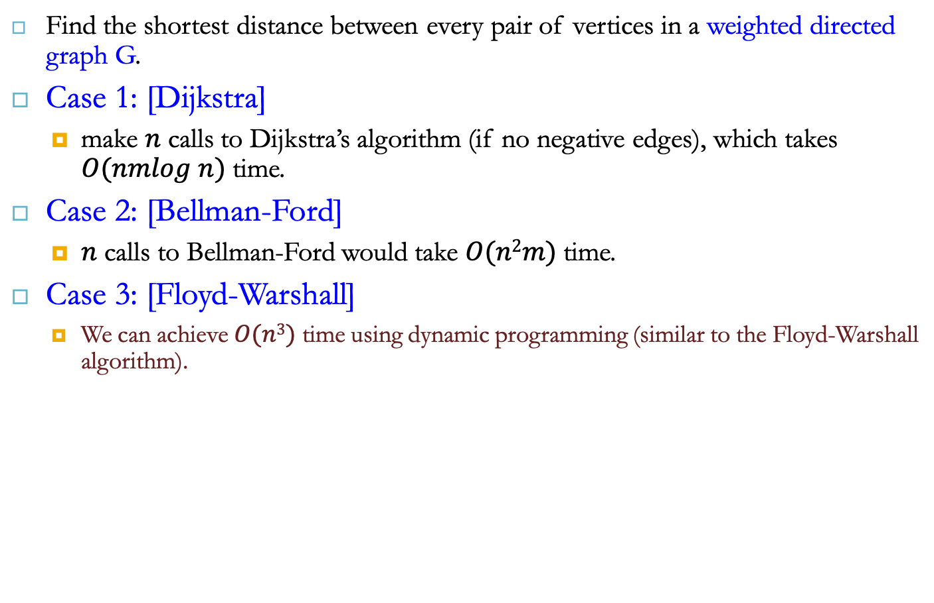
All-Pairs Shortest Paths
Find the shortest distance between every pair of vertices in a weighted directed graph G.
Case 1: [Dijkstra]
make $n$ calls to Dijkstra’s algorithm (if no negative edges), which takes $O(nmlog n)$ time.
Case 2: [Bellman-Ford]
$n$ calls to Bellman-Ford would take $O(n2m)$ time.
Case 3: [Floyd-Warshall]
We can achieve $O(n3)$ time using dynamic programming (similar to the Floyd-Warshall algorithm).
i
Uses only vertices numbered 1,…,k
(compute weight of this edge)
Uses only vertices
numbered 1,…,k-1
j
k
Uses only vertices
numbered 1,…,k-1

Slide 18
All-Pairs Shortest Paths
Floyd-Warshall Algorithm [Goodrich Book]
Algorithm AllPair(G) {assumes vertices 1,…,n}
for all vertex pairs (i,j)
if i = j
D₀[i,i] ← 0
else if (i,j) is an edge in G
D₀[i,j] ← weight of edge (i,j)
else
D₀[i,j] ← ∞
for k ← 1 to n do
for i ← 1 to n do
for j ← 1 to n do
D_{k}[i,j] ← min{D_{k-1}[i,j], D_{k-1}[i,k]+D_{k-1}[k,j]}
return D_{n}

Slide 19
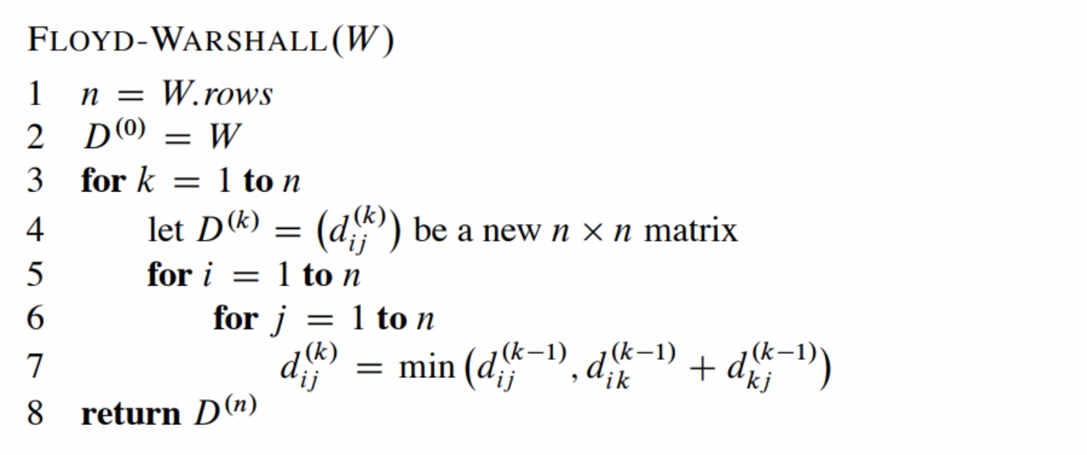
All-Pairs Shortest Paths
Floyd-Warshall Algorithm [Cormen]

Slide 20
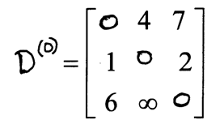
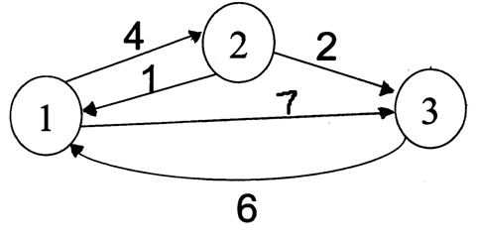
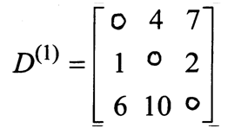
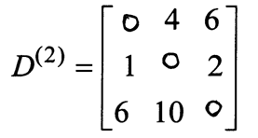
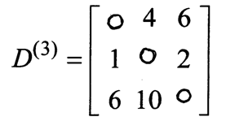
Floyd Warshall Algorithm - Example
Original weights.
Consider Vertex 1:
D(3,2) = D(3,1) + D(1,2)
Consider Vertex 2:
D(1,3) = D(1,2) + D(2,3)
Consider Vertex 3:
Nothing changes.

Slide 21
Floyd-Warshall Algorithm - Example
W
3
2
4
7
1
0 | 3 | 8 | ∞ | -4
∞ | 0 | ∞ | 1 | 7
∞ | 4 | 0 | ∞ | ∞
2 | ∞ | -5 | 0 | ∞
∞ | ∞ | ∞ | 6 | 0
1
3
8
-4
2
-5
5
4
6

Slide 22

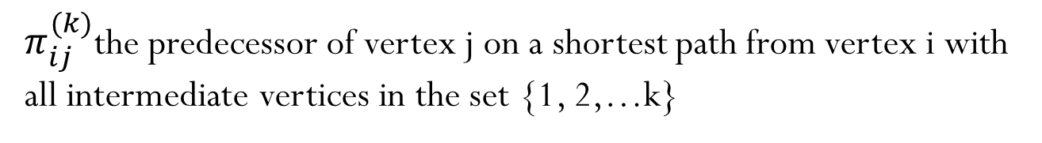
Floyd-Warshall Algorithm - Example
3
2
4
7
D⁽⁰⁾ Π⁽⁰⁾
1
1
3
0 | 3 | 8 | ∞ | -4
∞ | 0 | ∞ | 1 | 7
∞ | 4 | 0 | ∞ | ∞
2 | ∞ | -5 | 0 | ∞
∞ | ∞ | ∞ | 6 | 0
N | 1 | 1 | N | 1
N | N | N | 2 | 2
N | 3 | N | N | N
4 | N | 4 | N | N
N | N | N | 5 | N
8
-4
2
-5
5
4
6
$π_{ij}^{(k)}$the predecessor of vertex j on a shortest path from vertex i with
all intermediate vertices in the set {1, 2,…k}

Slide 23

Floyd-Warshall Algorithm
3
2
4
7
D⁽¹⁾ Π⁽¹⁾
1
1
3
0 | 3 | 8 | ∞ | -4
∞ | 0 | ∞ | 1 | 7
∞ | 4 | 0 | ∞ | ∞
2 | 5 | -5 | 0 | -2
∞ | ∞ | ∞ | 6 | 0
N | 1 | 1 | N | 1
N | N | N | 2 | 2
N | 3 | N | N | N
4 | 1 | 4 | N | 1
N | N | N | 5 | N
8
-4
2
-5
5
4
6
0 | 3 | 8 | ∞ | -4
∞ | 0 | ∞ | 1 | 7
∞ | 4 | 0 | ∞ | ∞
2 | ∞ | -5 | 0 | ∞
∞ | ∞ | ∞ | 6 | 0

Slide 24
Floyd-Warshall Algorithm - Example
3
2
4
7
D⁽²⁾ Π⁽²⁾
1
1
3
8
0 | 3 | 8 | 4 | -4
∞ | 0 | ∞ | 1 | 7
∞ | 4 | 0 | 5 | 11
2 | 5 | -5 | 0 | -2
∞ | ∞ | ∞ | 6 | 0
N | 1 | 1 | 2 | 1
N | N | N | 2 | 2
N | 3 | N | 2 | 2
4 | 1 | 4 | N | 1
N | N | N | 5 | N
-4
2
-5
5
4
6
0 | 3 | 8 | ∞ | -4
∞ | 0 | ∞ | 1 | 7
∞ | 4 | 0 | ∞ | ∞
2 | 5 | -5 | 0 | -2
∞ | ∞ | ∞ | 6 | 0

Slide 25
Floyd-Warshall Algorithm - Example
3
2
4
7
D⁽³⁾ Π⁽³⁾
1
1
3
0 | 3 | 8 | 4 | -4
∞ | 0 | ∞ | 1 | 7
∞ | 4 | 0 | 5 | 11
2 | -1 | -5 | 0 | -2
∞ | ∞ | ∞ | 6 | 0
N | 1 | 1 | 2 | 1
N | N | N | 2 | 2
N | 3 | N | 2 | 2
4 | 3 | 4 | N | 1
N | N | N | 5 | N
8
-4
2
-5
5
4
6
0 | 3 | 8 | 4 | -4
∞ | 0 | ∞ | 1 | 7
∞ | 4 | 0 | 5 | 11
2 | 5 | -5 | 0 | -2
∞ | ∞ | ∞ | 6 | 0

Slide 26
Floyd-Warshall Algorithm - Example
3
2
4
D⁽⁴⁾ Π⁽⁴⁾
7
1
1
3
0 | 3 | -1 | 4 | -4
3 | 0 | -4 | 1 | -1
7 | 4 | 0 | 5 | 3
2 | -1 | -5 | 0 | -2
8 | 5 | 1 | 6 | 0
N | 1 | 4 | 2 | 1
4 | N | 4 | 2 | 1
4 | 3 | N | 2 | 1
4 | 3 | 4 | N | 1
4 | 3 | 4 | 5 | N
8
-4
2
-5
5
4
6
0 | 3 | 8 | 4 | -4
∞ | 0 | ∞ | 1 | 7
∞ | 4 | 0 | 5 | 11
2 | -1 | -5 | 0 | -2
∞ | ∞ | ∞ | 6 | 0

Slide 27
Floyd-Warshall Algorithm - Example
3
2
4
7
D⁽⁵⁾ Π⁽⁵⁾
1
1
3
0 | 1 | -3 | 2 | -4
3 | 0 | -4 | 1 | -1
7 | 4 | 0 | 5 | 3
2 | -1 | -5 | 0 | -2
8 | 5 | 1 | 6 | 0
N | 3 | 4 | 5 | 1
4 | N | 4 | 2 | 1
4 | 3 | N | 2 | 1
4 | 3 | 4 | N | 1
4 | 3 | 4 | 5 | N
8
-4
2
-5
5
4
6
0 | 3 | -1 | 4 | -4
3 | 0 | -4 | 1 | -1
7 | 4 | 0 | 5 | 3
2 | -1 | -5 | 0 | -2
8 | 5 | 1 | 6 | 0

Slide 28
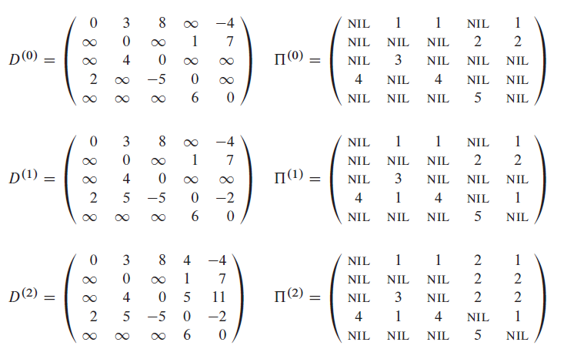
Example 2

Slide 29
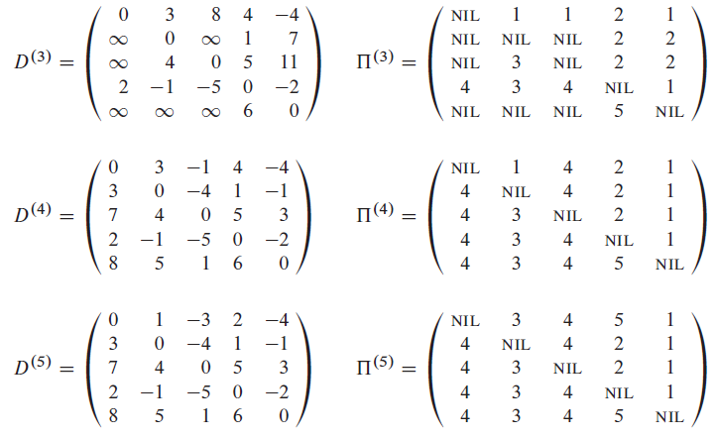
Example 2 (cont.)
Find path from 2 to 5?
Notes:
Find path from 2 to 5?
(2, 5) = 1; (2, 1) = 4; (2,4) = 2 => 2 -> 4 -> 1 -> 5

Slide 30
Reference2
Algorithm Design: Foundations, Analysis, and Internet Examples. Michael T. Goodrich and Roberto Tamassia. John Wiley & Sons.
Introduction to Algorithms. Thomas H. Cormen, Charles E. Leiserson, Ronald L. Rivest, Clifford Stein.

Slide 31
Thank you!

